Slide 1

Software Vulnerabilities & the OS
With a quick review of processes and race-condtions

Slide 2
First a quick discussion
Open the Attendance Quiz now available (I just published it)
Enter the Password on the Board
Password will expire at 9:10
Discuss the question with your group and select your answer
You will get full credit no matter what choice
There is a correct answer

Slide 3

Now an intermission
Let’s remember we should be building an assessment and see what the last month looks like
Work on Project – 2 code items
Work on Project – 3 of any items
Build Security Assessment while doing this
Complete TryHackMe to build knowledge of pentesting
Quizzes and Final

Slide 4

Topics
OS operations:
Multiple Users
Multiple Processes
Race-Conditions with & without processes
Access Control issues (let’s remember those file operations)

Slide 5
How an OS works
Very brief overview

Slide 6
How many people have logged into your workstation?
I know, with our personal computers we forget about multiusers
But this is the default state of business
This leads to 2 problems
Multiple Processes
Shared Resources

Slide 7
Multiple Processes
Let’s see how many processes are running (and visible) – open task manager (windows) or activity manager (apple)
Windows: Ctrl+Shift+Esc
Apple: Finder -> Applications -> Utility and select it
How many programs do you see and recognize?
Check out Chrome (or whatever you’re using for the web) how many different processes do you see for this one program?

Slide 8
Processes vs. Programs
A process is different than a program
Program: Static code and static data (already saved)
Process: Dynamic instance of code and data (its running)
No one-to-one mapping between programs and processes
Can have multiple processes of the same program Example: many users can run “ls” at the same time
One program can invoke multiple processes Example: “make” runs many processes to accomplish its work

Slide 9
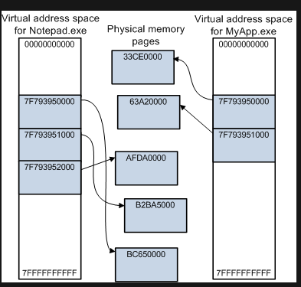
Address Space
The processes also includes the address space
Everything process can address through memory
Represented by array of bytes
Heap, stack, and code
This should sound familiar
Notes:
From MS Driver Notes

Slide 10
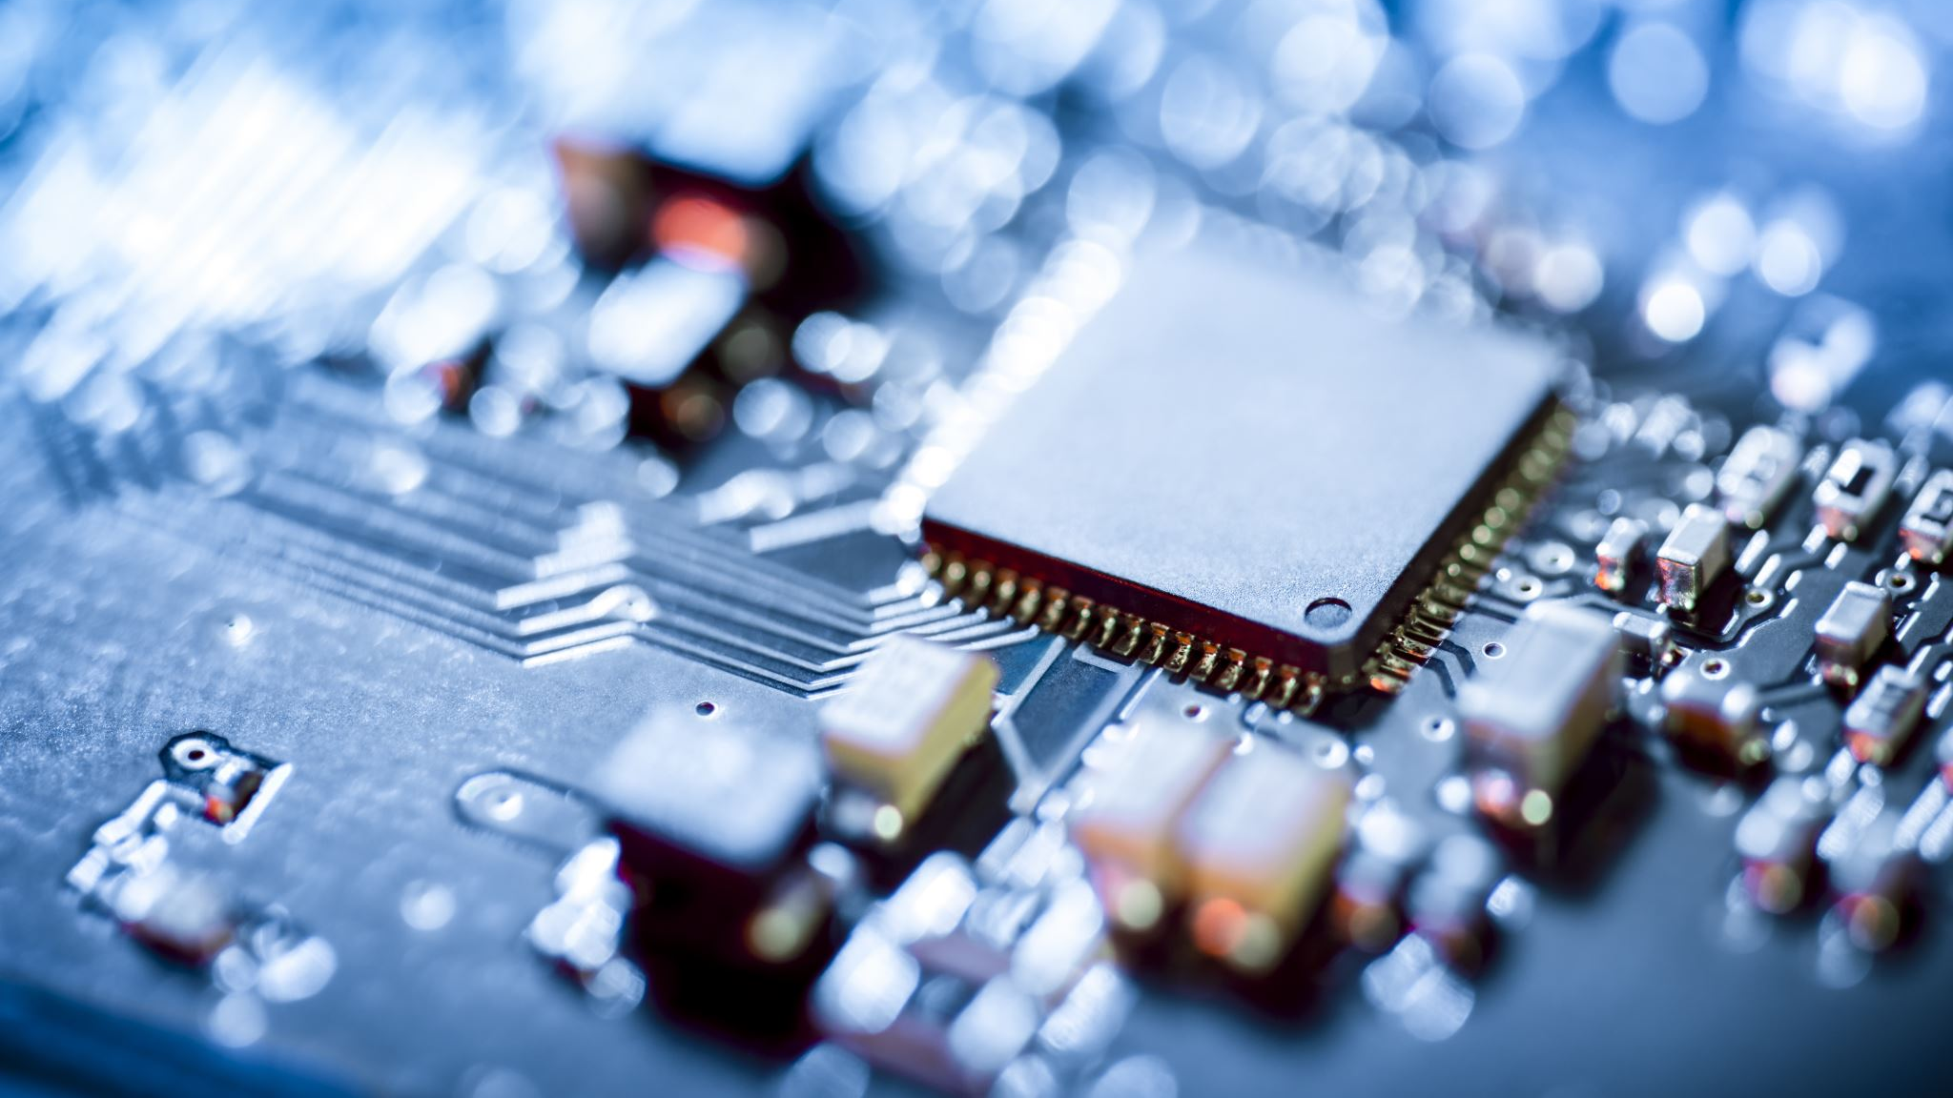
See board – quick overview of how processes load in memory/cpu

Slide 11
The Problem?
So many users and processes

Slide 12
Let’s look at what happens when we add a file (or DB) – on board
everyone must share this file – let’s say an CSV file
Start with just one program with multiple processes (show how to do that on Thursday)
Then multiple users (running multiple processes)
What do you think will happen because of this?

Slide 13

So what happens when two people need a file at the same time?
It helps to know how append vs. read and write works and seek
Append moves the pointer (seeker) forward until it hits EOF
Read & write does the same but reads the whole file first then starts writing at EOF+1
Seek moves the its pointer around the file and writes/reads when it wants
Let’s see how this can cause a race condition
So what will happen?

Slide 14
Want another fun one?
When people create a file or directory with the same name but different casing (oh, I hate this one)
Mac until latest version
Windows until late 10 update (about 2021 I think, still broken in 2020)
Such as “Myfiles” vs. “MyFiles”
Let’s see what happens here

Slide 15
How do we fix?
We’ll look at a few methods on Thursday’s video lecture
Locking
Mutual Exclusion
Async Events
Won’t focus as much on code due to fact that most are not using multi-processes but may have multi-user issues (web-based items esp.)
Will also show how this makes buffer overflows attack worse
And Access Permissions part 1

Slide 16
From Here
Thursday online lecture
Quiz and HackerRank Assignment
Enjoy your holidays

